Slide 1
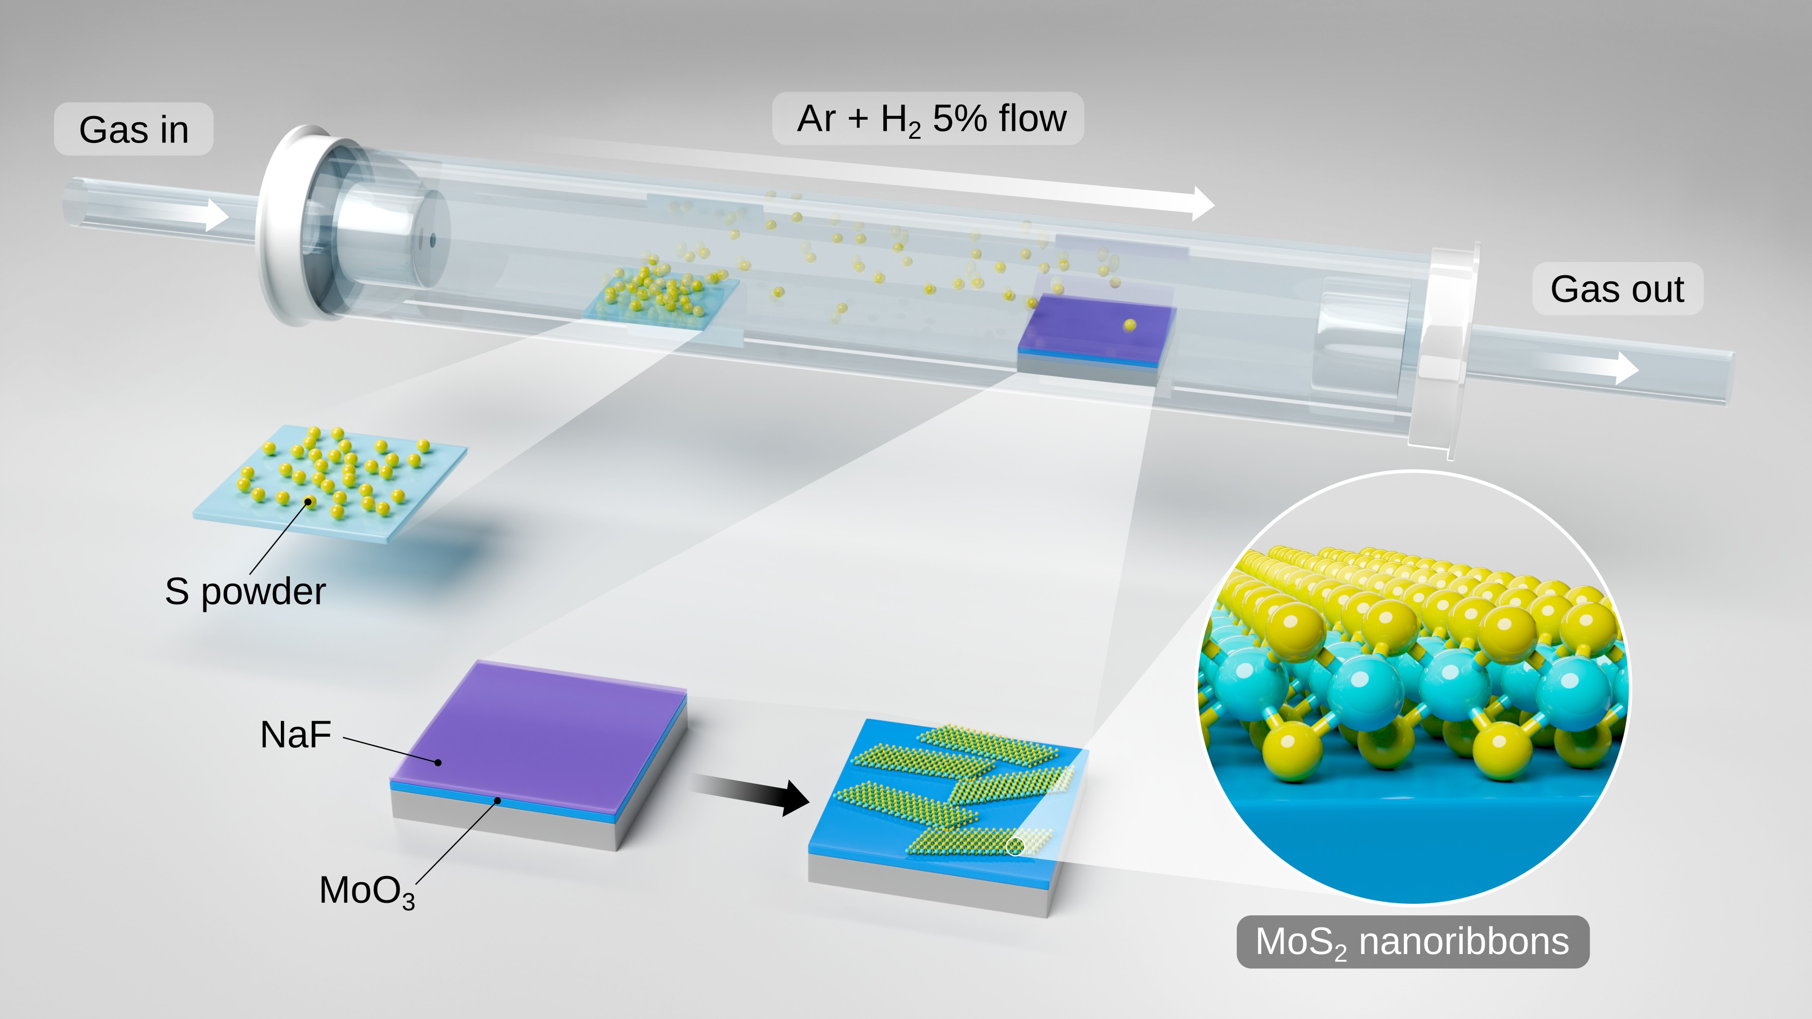
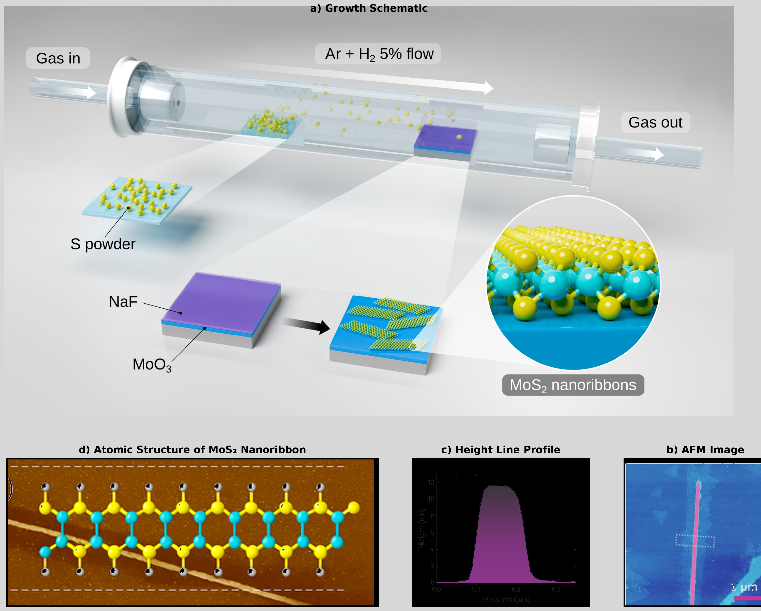
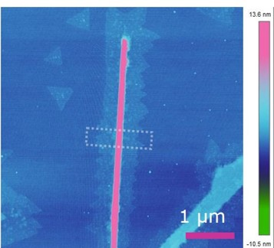
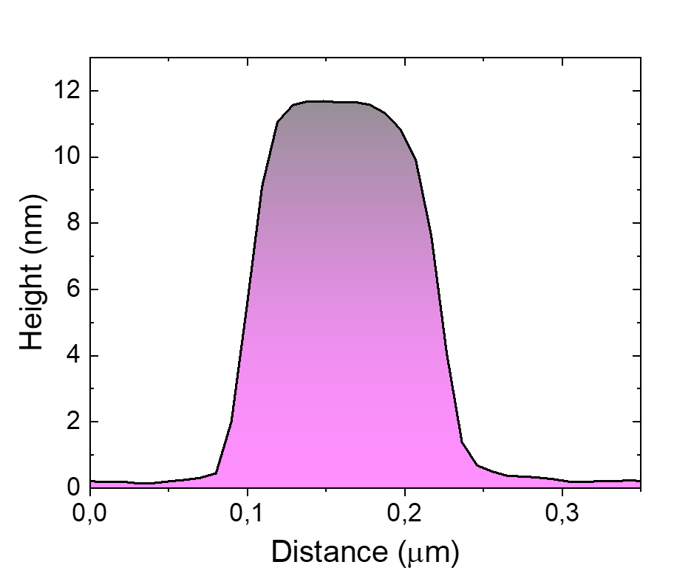
(a) Growth Schematic
(b) Atomic Structure of the MoS₂ Nanoribbon
(c) AFM Image
(d) Height Line Profile

